Slide 1


Pitch Deck Outline How Each Slide Should Help Answer Certain Questions
3

Slide 2

YOUR COMPANY NAME
One-liner description

Slide 3
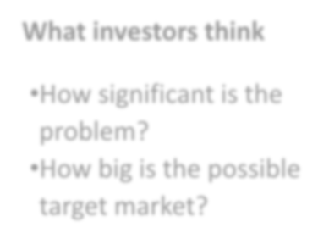
Problems
What are the pain points? Why does it matter to solve this? Is there any existing solution?
Key points
Current issues
Unmet market demand
Case study or founders’ experience
Why the current solution doesn’t work?
What investors think
How significant is the
problem?
How big is the possible target market?
Tips
Show how it relevant to the audience

Slide 4
Solutions
What do you do? How does it solve the problem? What makes it different?
Key points
About your products or services
Key features that makes your product stand out
User journey shows a brief process on how it works
What investors think
How well you address the problem? Investors want to check the product-market fit.
Tips
Time to showcase product demo/ snapshot and/or prototype

Slide 5
Target Customers Who will buy your products/services?
Key points
Users vs customers
What is their profile?
You cannot target everyone
What investors think
What is the market opportunity? Is it going to be big?
Tips
Create a customer persona if it helps!

Slide 6
Market Sizing How big is the market opportunity?
Key points
Market volume:
Number of target customers × Penetration rate
TAM, SAM, SOM
Market value:
Market volume × Average value
What investors think
How big is your market?
Tips
Data is a key!
https://www.thebusinessplanshop.com/blog/en/entry/tam_sam_som

Slide 7
Competition Landscape How big is the market opportunity?
Key points
Direct competitors vs potential competitors
Potential competitors: those who might jump into
your market in future
How are you going to win the competition?
What investors think
VCs are attracted in mass and lifestyle business but not really in niche.
Angels are more open.
Tips
Adjust the positioning according to your company

Slide 8
Business Model How do you gain revenue?
Key points
For early-stage: specify the current and future model
Examples: subscription fee, sales margin, transaction fee
Can also mention: Wholesale (B2B), Retail (B2C)
What investors think
How will the revenue stream help the company to scale? Is it sustainable?
Tips
You can provide some diagrams if it helps

Slide 9
Traction
What have you achieved?
Key points
When was it firstly founded?
Key achievements, examples:
Number of customers
Total revenue, GTV, GMV
Geographical reach
Acknowledgement (awards, media coverage)
What investors think
Validation! Any proof that your product can address the problem?
Tips
Understand the key metrics in your industry

Slide 10
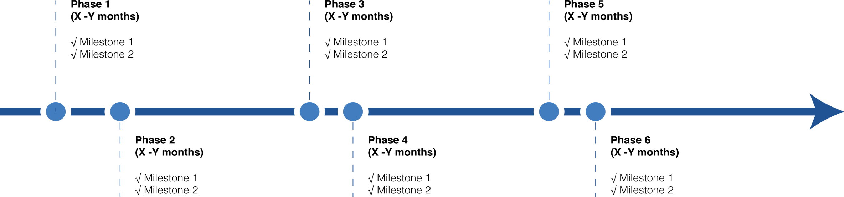
Milestones

Slide 11
Team Who are the key people in the team? What are their roles?
Key points
3-5 key people in the team
Position in the team
Any relevant background/experience?
You can include key investors and advisors
What investors think
Is it the winning team? Do they have skin in the game? Are they reliable and solid?
Tips
Show pictures, especially during the pitching session

Slide 12
The Ask What do you need from me?
What investors think
Why do we have to invest now?
Why do we have to invest in your company not others?
What do you need to succeed?
Key points
Your investment ask
Runway period
Funding allocation
Non-monetary support you need
Why us and why now
Tips
Be strategic, it is a trigger for further discussion

Slide 13

Contact Details
Address
ABC Street, Alexandria 12345
Phone Number
+2012345678
Email Address
info@companyname.com
Website
www.companyname.com

